Slide 1
Web accessibility
Lindsay Green​
WDD230

Slide 2
What is Web accessibility?
Web accessibility is the concept of creating a website that is accessible to all users—easy to find, navigate, and understand.

Slide 3


Slide 4
Four components (P.O.U.R.)
Perceivable​
Operable
​Understandable
Robust​

Slide 5
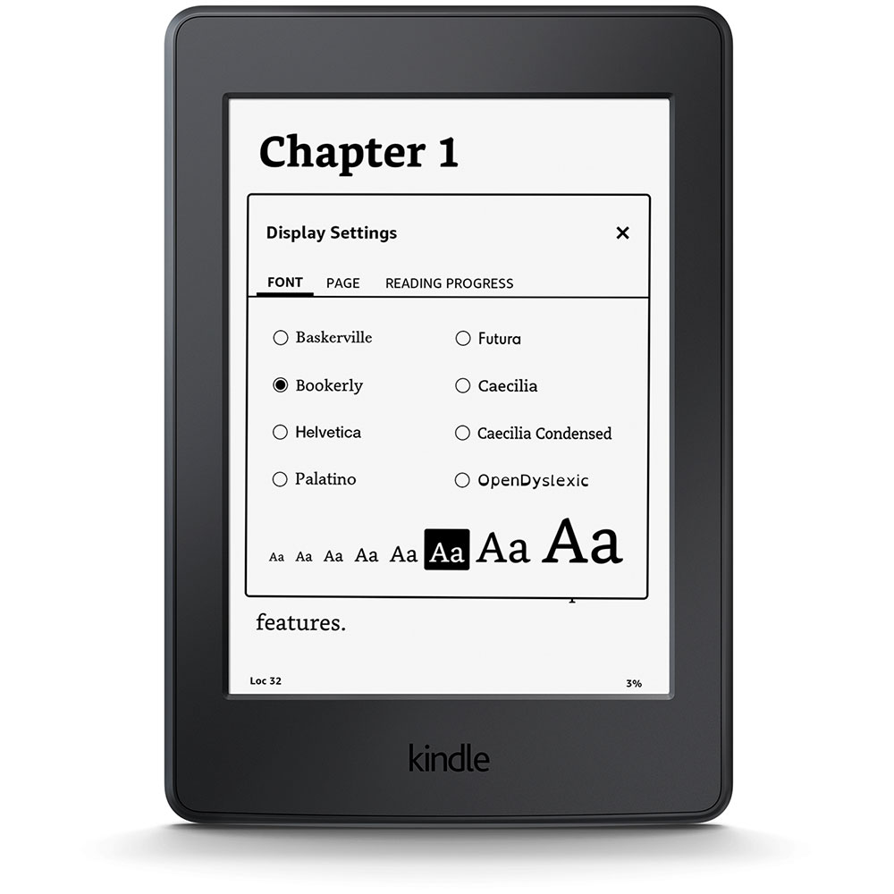

Slide 6
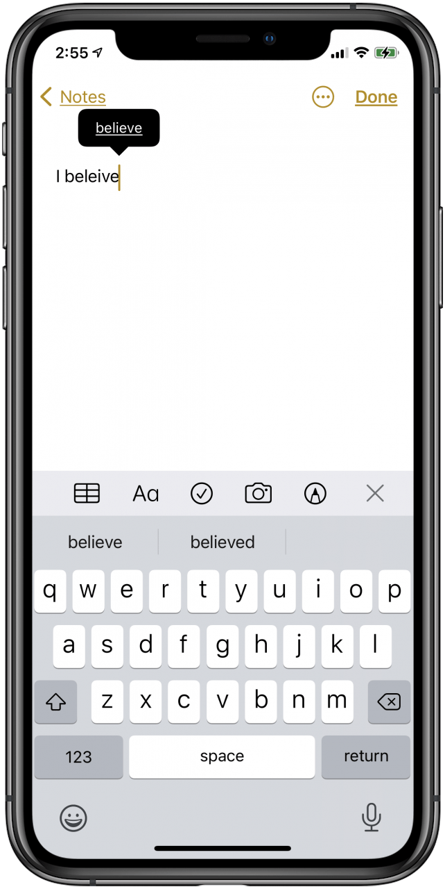
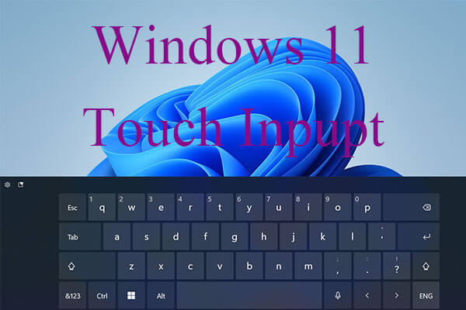

Slide 7
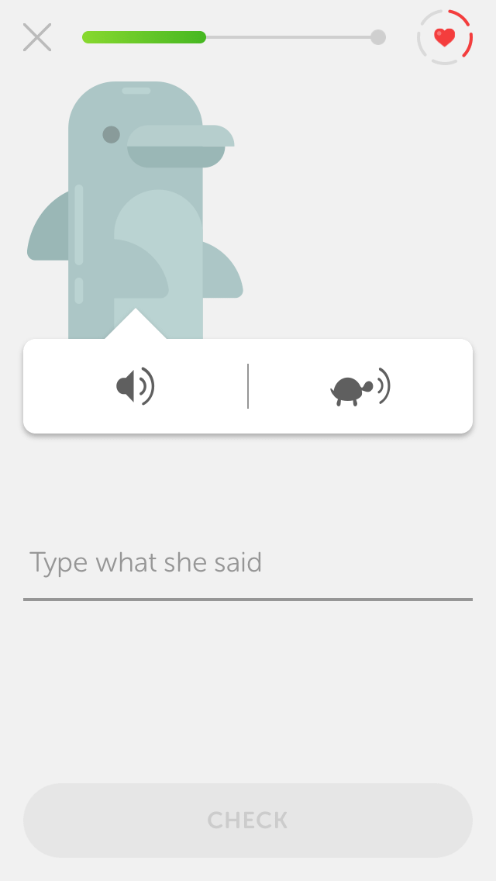
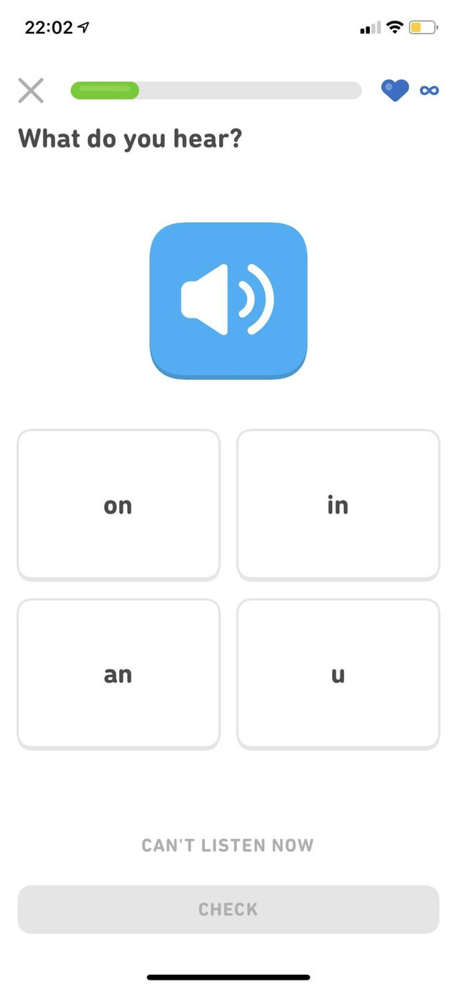

Slide 8
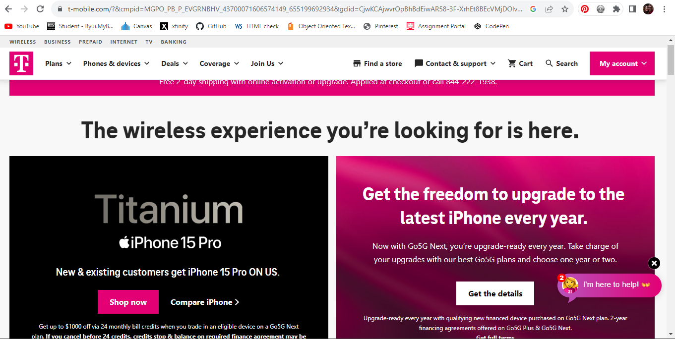

Slide 9
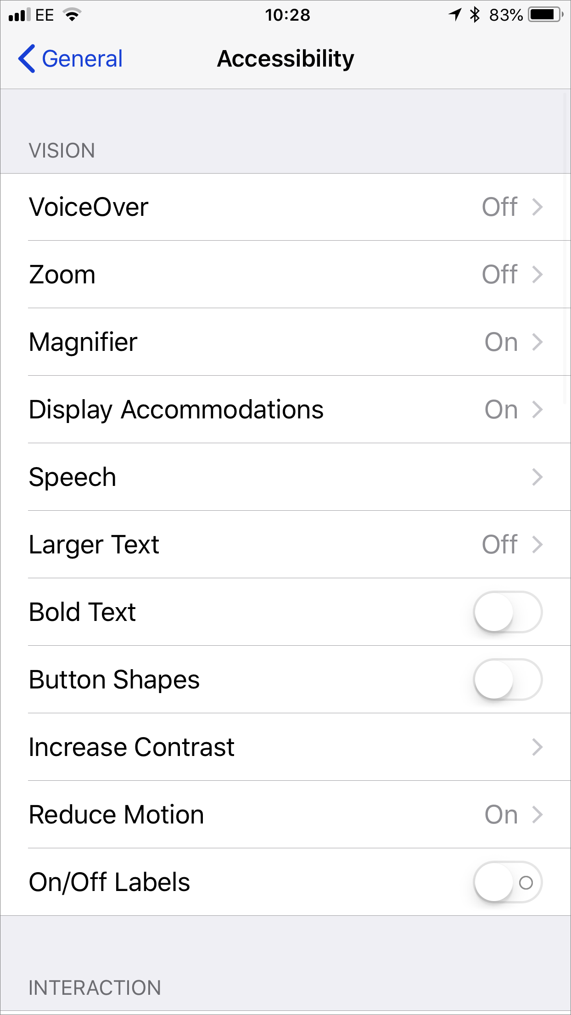
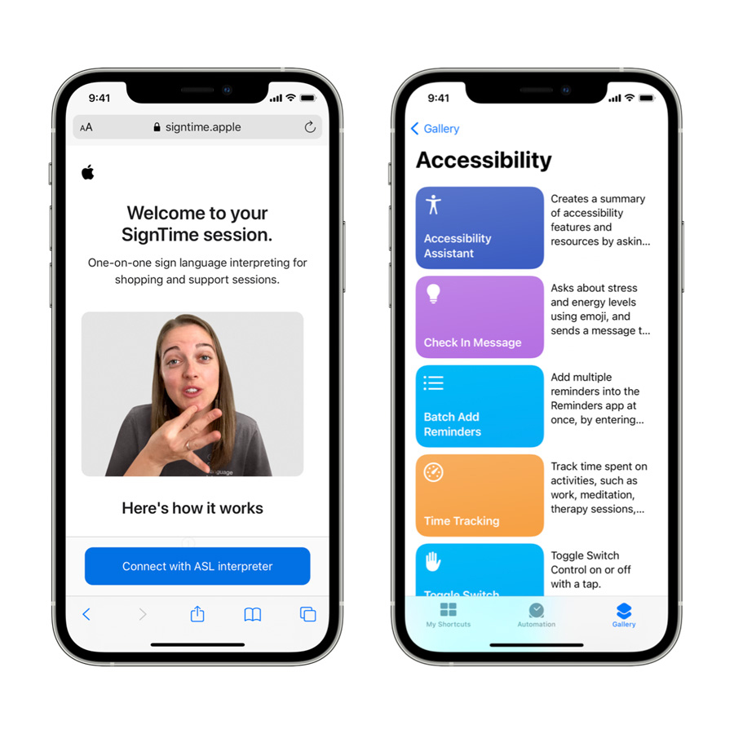

Slide 10
CONCLUSION

